Slide 1
Maverick* Research: Metaverses Will Be the Place With Empathy
Download this presentation as an attachment to the main research piece to be used as a presentation material for your board.
Notes:
Ver 2021-1201
Presenter's Name
Presenter's Name

Slide 2
Gartner Maverick* research delivers breakthrough, disruptive and sometimes contradictory ideas that challenge conventional thinking. Formed in our research incubator, it is designed to explore alternative opportunities and risks that could influence your strategy.
This Maverick research breaks new ground by introducing the idea that empathy in a virtual world should come first that will make the metaverse successful. Its findings and advice should therefore be treated with caution.

Slide 3
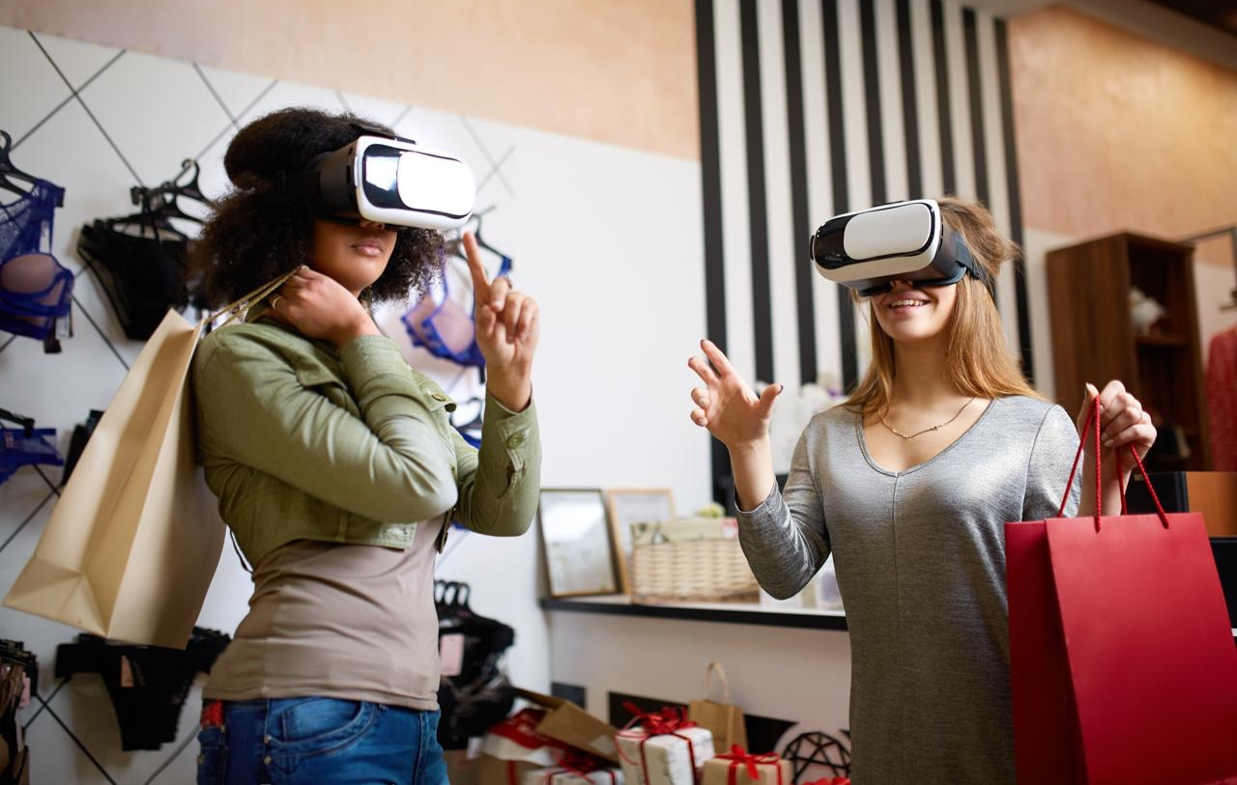
Foreword
Gartner defines a metaverse as, “A collective virtual shared space, created by the convergence of virtually enhanced physical and digital reality. A metaverse is persistent, providing enhanced immersive experiences.” In the context of this discussion, metaverse includes virtual immersive experience.
One goal of metaverse is making an extension of our virtual presence using 3D visualization.
Metaverse is the place where DEI is kept in consideration, disabilities are not part of your identity unless you want them to be
Great example is Ironmouse which has demonstrated that despite various limitations there is wider acceptance
Source: Gartner
Notes:
One goal of metaverse is making an extension of our virtual presence using 3D visualization. Our flaws and human-ness are going to be carried over to the metaverse as well. Physical approximations of avatars that track physical movement and facial expressions in real time are getting closer to realistic levels due to technology advancements made in the metaverse space.
However, we can think of metaverse as the place to be when the real world falls short of meeting expectations. The pursuit of equality for everyone has fallen woefully short in the actual world. However, metaverse could be the place where DEI is kept in consideration, disabilities are not part of your identity unless you want them to be, and everyone is treated the same way. A great example of this is Ironmouse which has demonstrated that despite various limitations there is wider acceptance. Another good examples are diversification of emojis so you can customize your responses based on your personal identity or diversification of skins. Metaverse can be the place where people go knowing they will find empathy.
https://brand.gartner.com/downloads/5ddf10972a7df/sm_2019_GettyImages-931145294.jpg.jpg

Slide 4

Connection Between Empathy and Metaverse
The definition of empathy encompasses a broad range of phenomena, including caring for other people and having a desire to help them and making less distinct the differences between the self and the other.
Gaping lack of empathy in current design of Metaverse
Right now, the metaverse can function as an escape place where you don't want any connection with the real world
The bedrock of building a long-term metaverse is empathy
Source: Gartner
Notes:
The definition of empathy encompasses a broad range of phenomena, including caring for other people and having a desire to help them; experiencing emotions that match another person's emotions; discerning what another person is thinking or feeling; and making less distinct the differences between the self and the other.
Currently the path Metaverse is going towards, there is a gaping lack of empathy. The negative news that comes out concerning safety features or harassment certainly don't help with building it as a destination for community building (https://www.bloomberg.com/opinion/articles/2022-02-21/metaverse-harassment-doesn-t-bode-well-for-zuckerberg-s-vr-dreams).
Right now, the metaverse can function as an escape place where you don't want any connection with the real world. In that case, we would treat metaverse purely as a place that is different from the real world and strive to keep it that way. However, that would be ok for a short term.
To run a parallel-universe without a concerted focus on empathy would probably be ok for a short term with short term business goals. In the long term, metaverse will probably not survive without empathetic designs. Instead of treating metaverse as a fad, lets design the metaverse with considerations for everyone –with empathy-- which will make it exist 10, 30, 50 years from now.
The bedrock of building a long-term metaverse is empathy. The definition of empathy encompasses a broad range of phenomena, including caring for other people and having a desire to help them; experiencing emotions that match another person's emotions; discerning what another person is thinking or feeling; and making less distinct the differences between the self and the other.
https://brand.gartner.com/file/gallery/id/20884

Slide 5
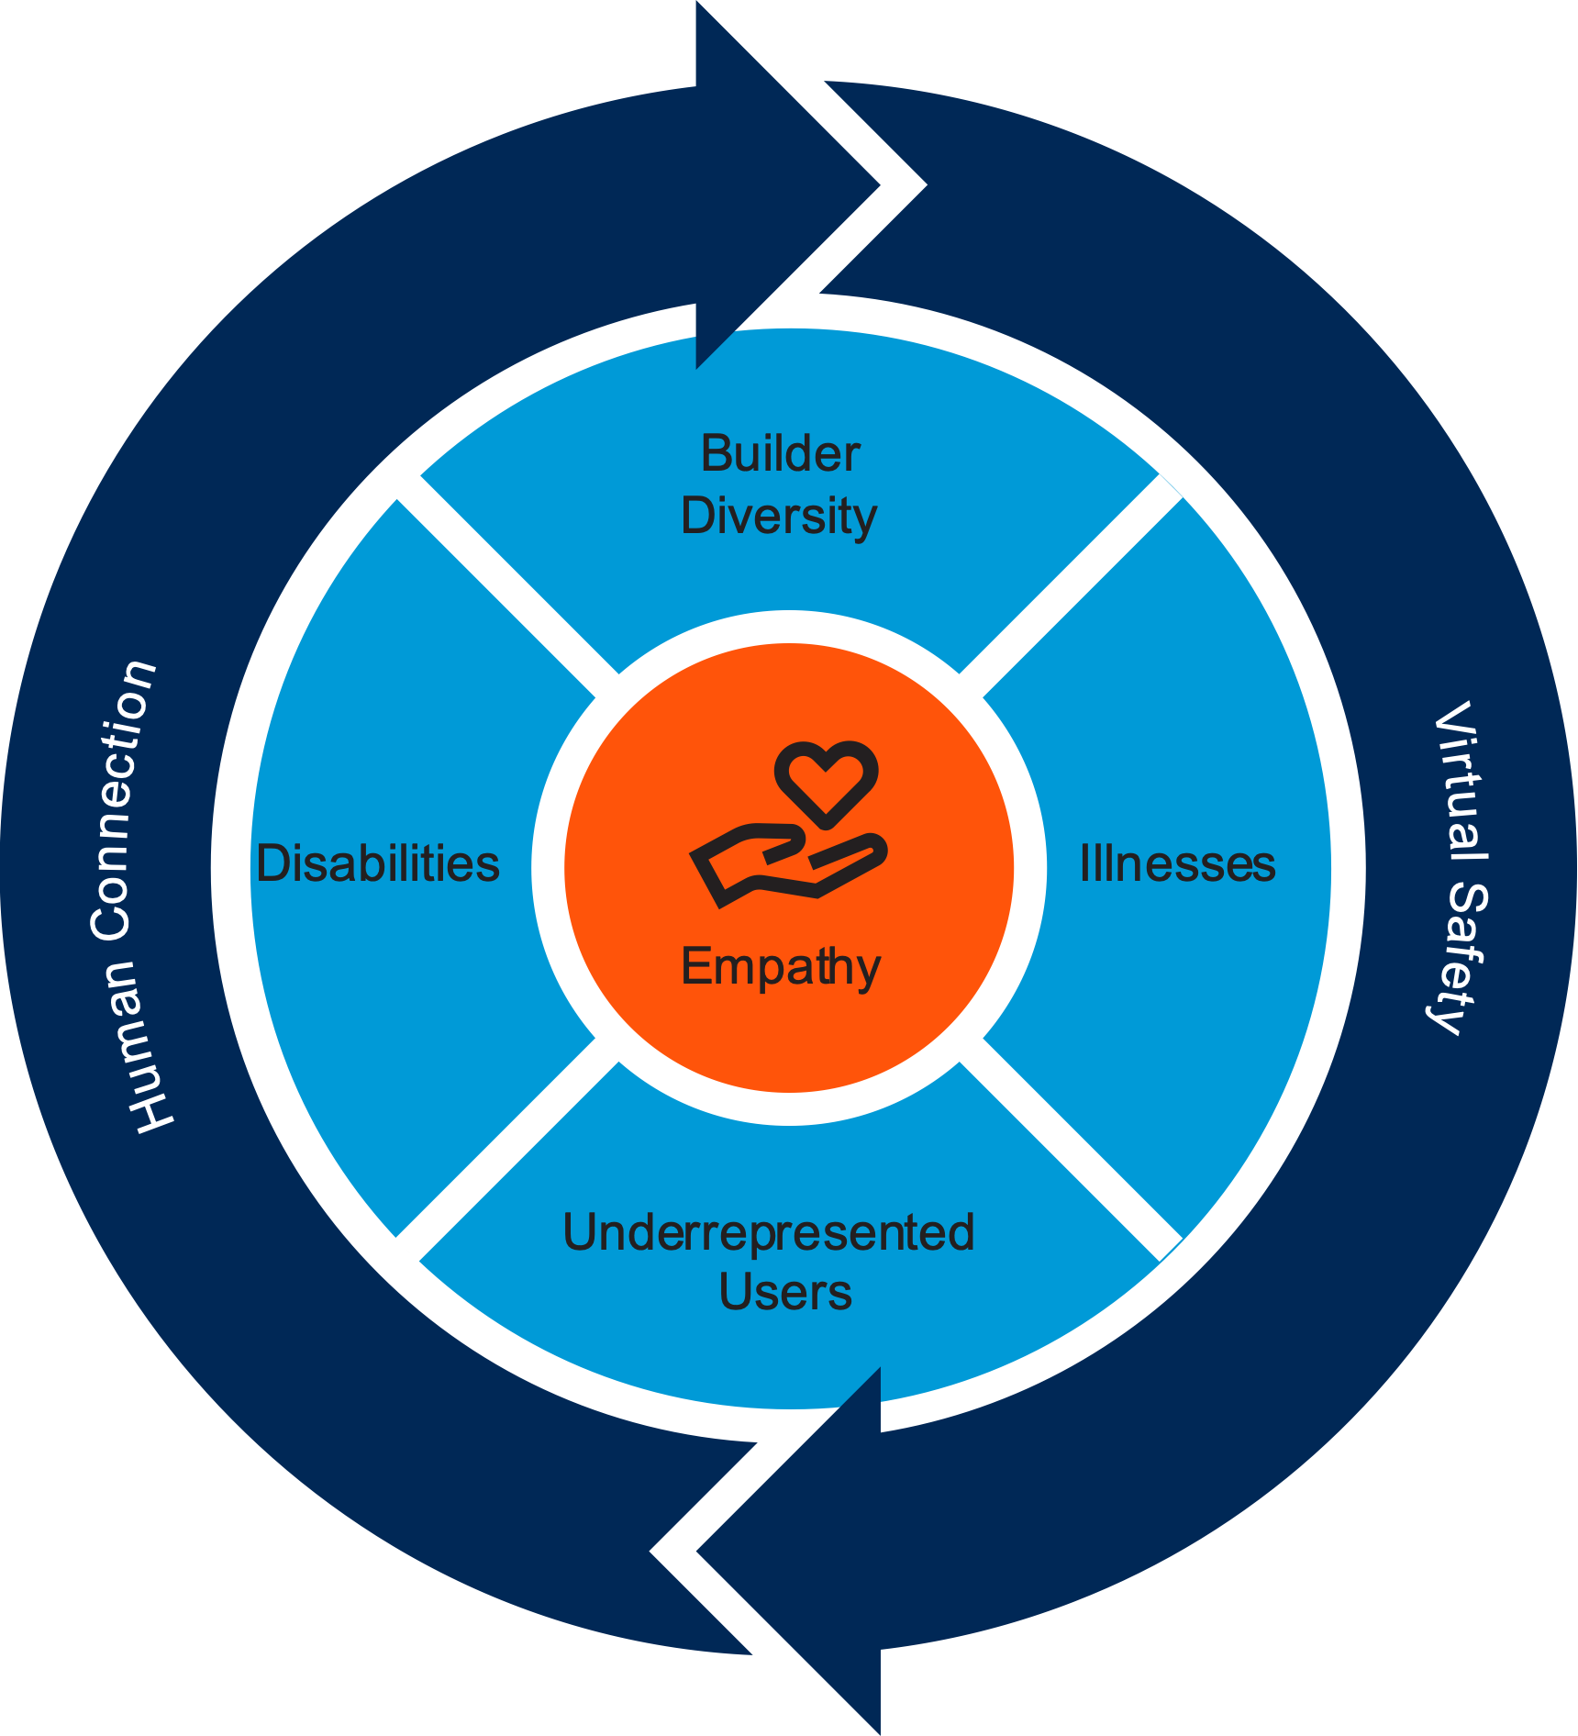
Empathy Should Be the Bedrock of Metaverse Design
Source: Gartner
Notes:
There are two basic principles that are underarching to make it empathetic by design - Human Connection and Virtual Safety. Further to this discussion to make the metaverse expansive and inclusive, we need to address real-world challenges that humans experience including, but not limited to Disability, Illness, Builder Diversity and Under-represented.

Slide 6
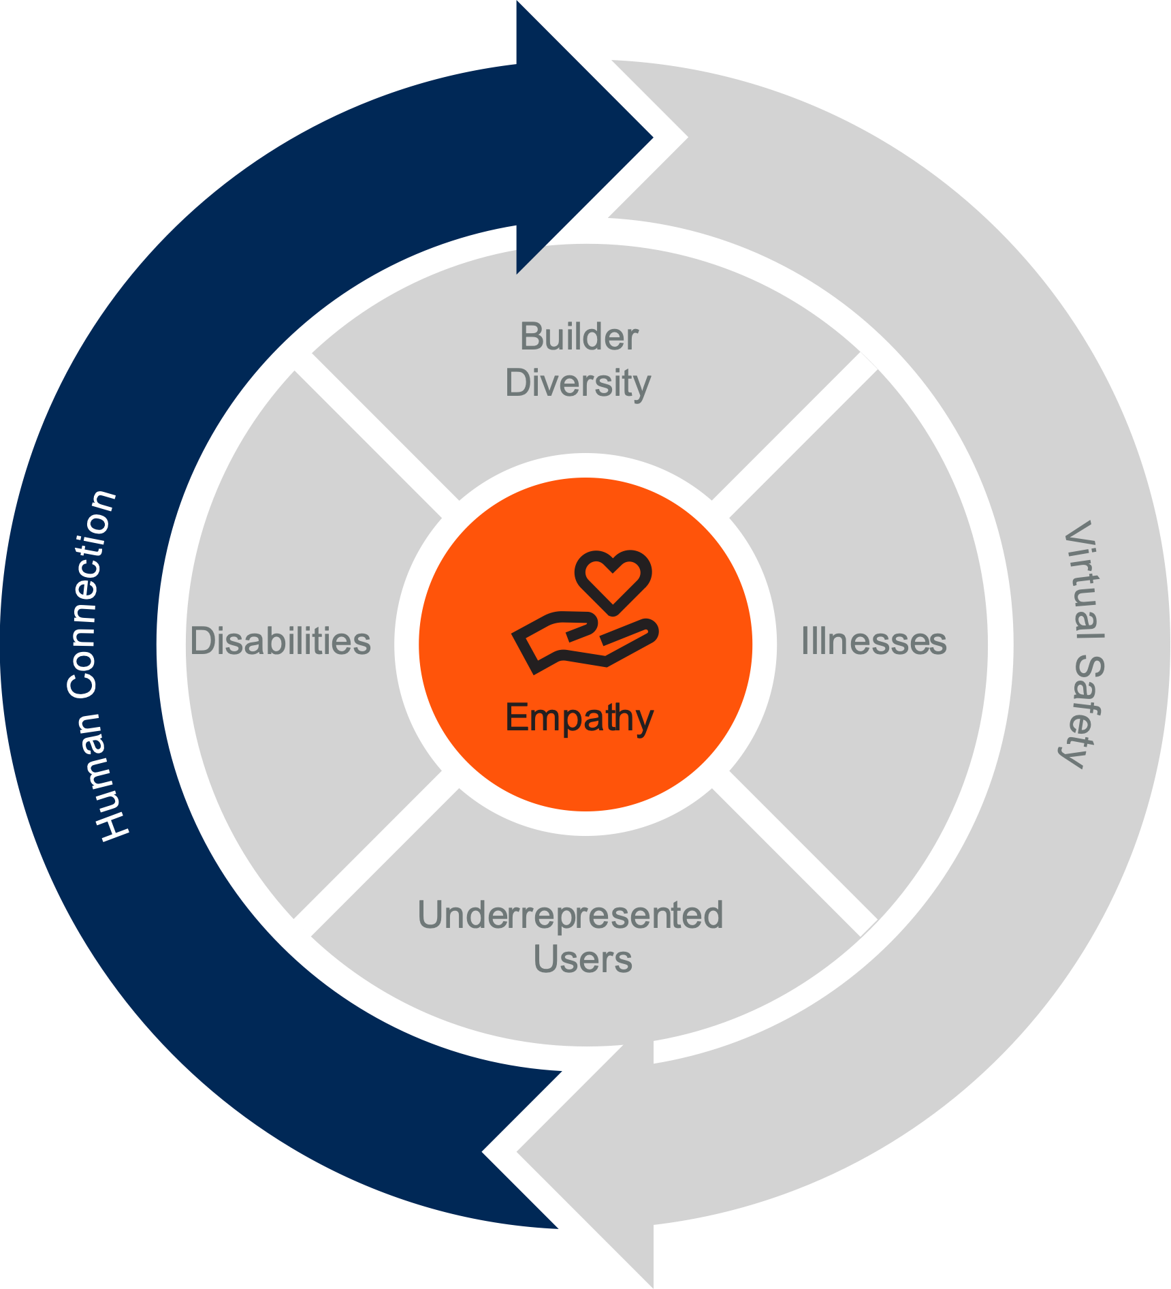
Principle 1: Human Connection
Designing a virtual experience where you are as connected as you would be to a real person in a real world
Design aspects of an avatar to make it more real, focusing on traits like compassion and altruism
Making avatars representative of your perceptive empathetic self
How can you design an experience that will make it the same as one you would experience in a real world?
Source: Gartner
Notes:
We need and look for human connection in everything we do. The whole reason for designing a virtual world is to feel who you are interacting with when you are online
You want to create an experience that will embed empathy in all of the virtual design you create, starting from how people interact with others in the metaverse (Example: embedding closed captioning for folks with hearing issues). Make mental connections by making it easy for people to share experiences and feelings.
An Avatar is an online representation of a user. This digital identity differs from person to person and can either be static or animated. Meta is, however, studying physical movements and then training virtual avatars using those studies. These studies are helping the model accurately predict things like shoulder and elbow positions based on where your headset and controllers are. Those studies would be helpful to make the avatar feel more realistic. Metaverse creators need to also focus on behavioral aspects like compassion and caring for other people when designing these virtual spaces.
Design personas need to bring in understanding of body language and facial expressions. There is a fair bit being done in this space to make the virtual avatars imitate gestures/features of a real person by making it as realistic as possible. However, the design aspects should also focus on making the experience as positive as ever that can help take it a step further. You need to think about how to physically code in someone’s positive traits and identity and represent it on screen.
Teach human connection – Domestic abuse example, how to teach the other person in their place. Actively teaching empathy in the real world
General guidelines that avatars are positive attributes of behavior
Promoting positive behavior

Slide 7
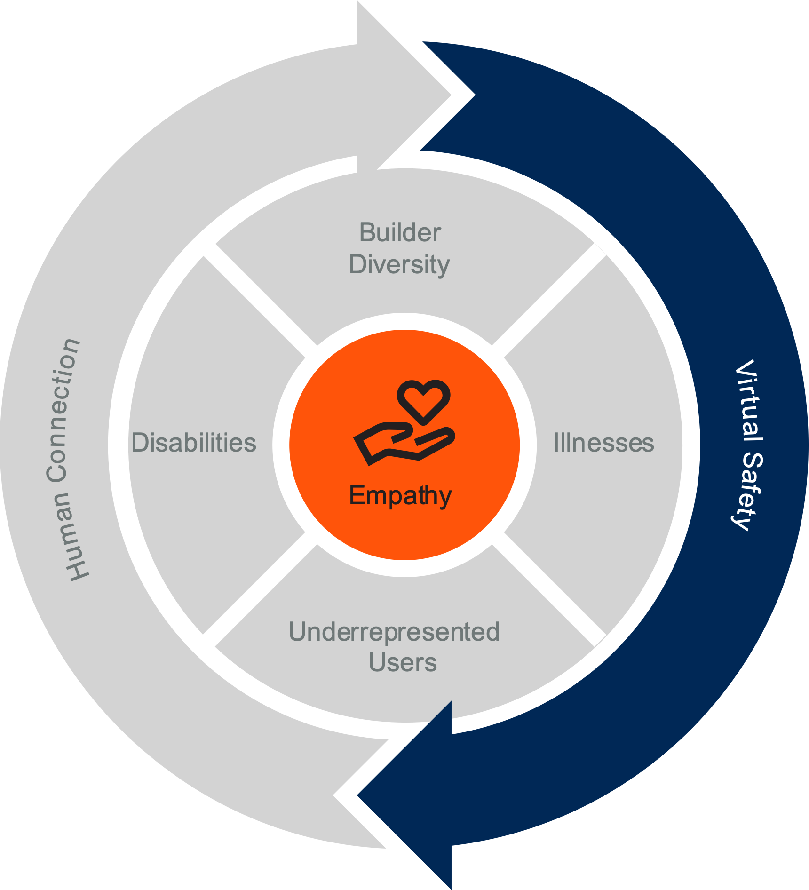
Principle 2: Virtual Safety
Policing Bad Behavior to Weed out the Bad Actors
Building Standard Set of Rules to Police Bad Behavior
Interoperability and Interdimensionality of Virtual Worlds with Ways to Share Information
We need to feel safe in any environment, especially if it’s a new place.
Source: Gartner
Notes:
We need to feel safe in any environment, especially if it’s a new place. Without a sense of control in a virtual environment and lack of knowing who you are standing next to, it becomes hard to understand where you are and your sense of safety.
There is no incentive currently to weed out bad actors but metaverse builders need to work on how to protect users from bad behavior. There are numerous examples of incidents in which users experienced hate speech. On an ongoing basis, these will be a deterrent for users who want to have a good experience when they are in a virtual world. Builders must include a mechanism that disciplines users engaging in negative behavior, making them ineligible to participate online for specified periods and/or participating in programs that promote empathy. For example, bad actors are found and suspended or banned and have to go through some behavioral metaverse training.
People can currently report the user accounts when they experience bad behavior but it’s currently up to individual companies - they may each have their standards but are lacking strong enforcement mechanisms. Global standards should be created and monitored for adherence. Allowing users to set preferences for types of acceptable interactions based on personal behavioral preferences.
Another way would be to create an ecosystem where virtual worlds can freely share information between platforms so that bad actors are reported on every platform, and they don’t go scot-free. (Similar to global Know Your Customer rules and platforms)

Slide 8
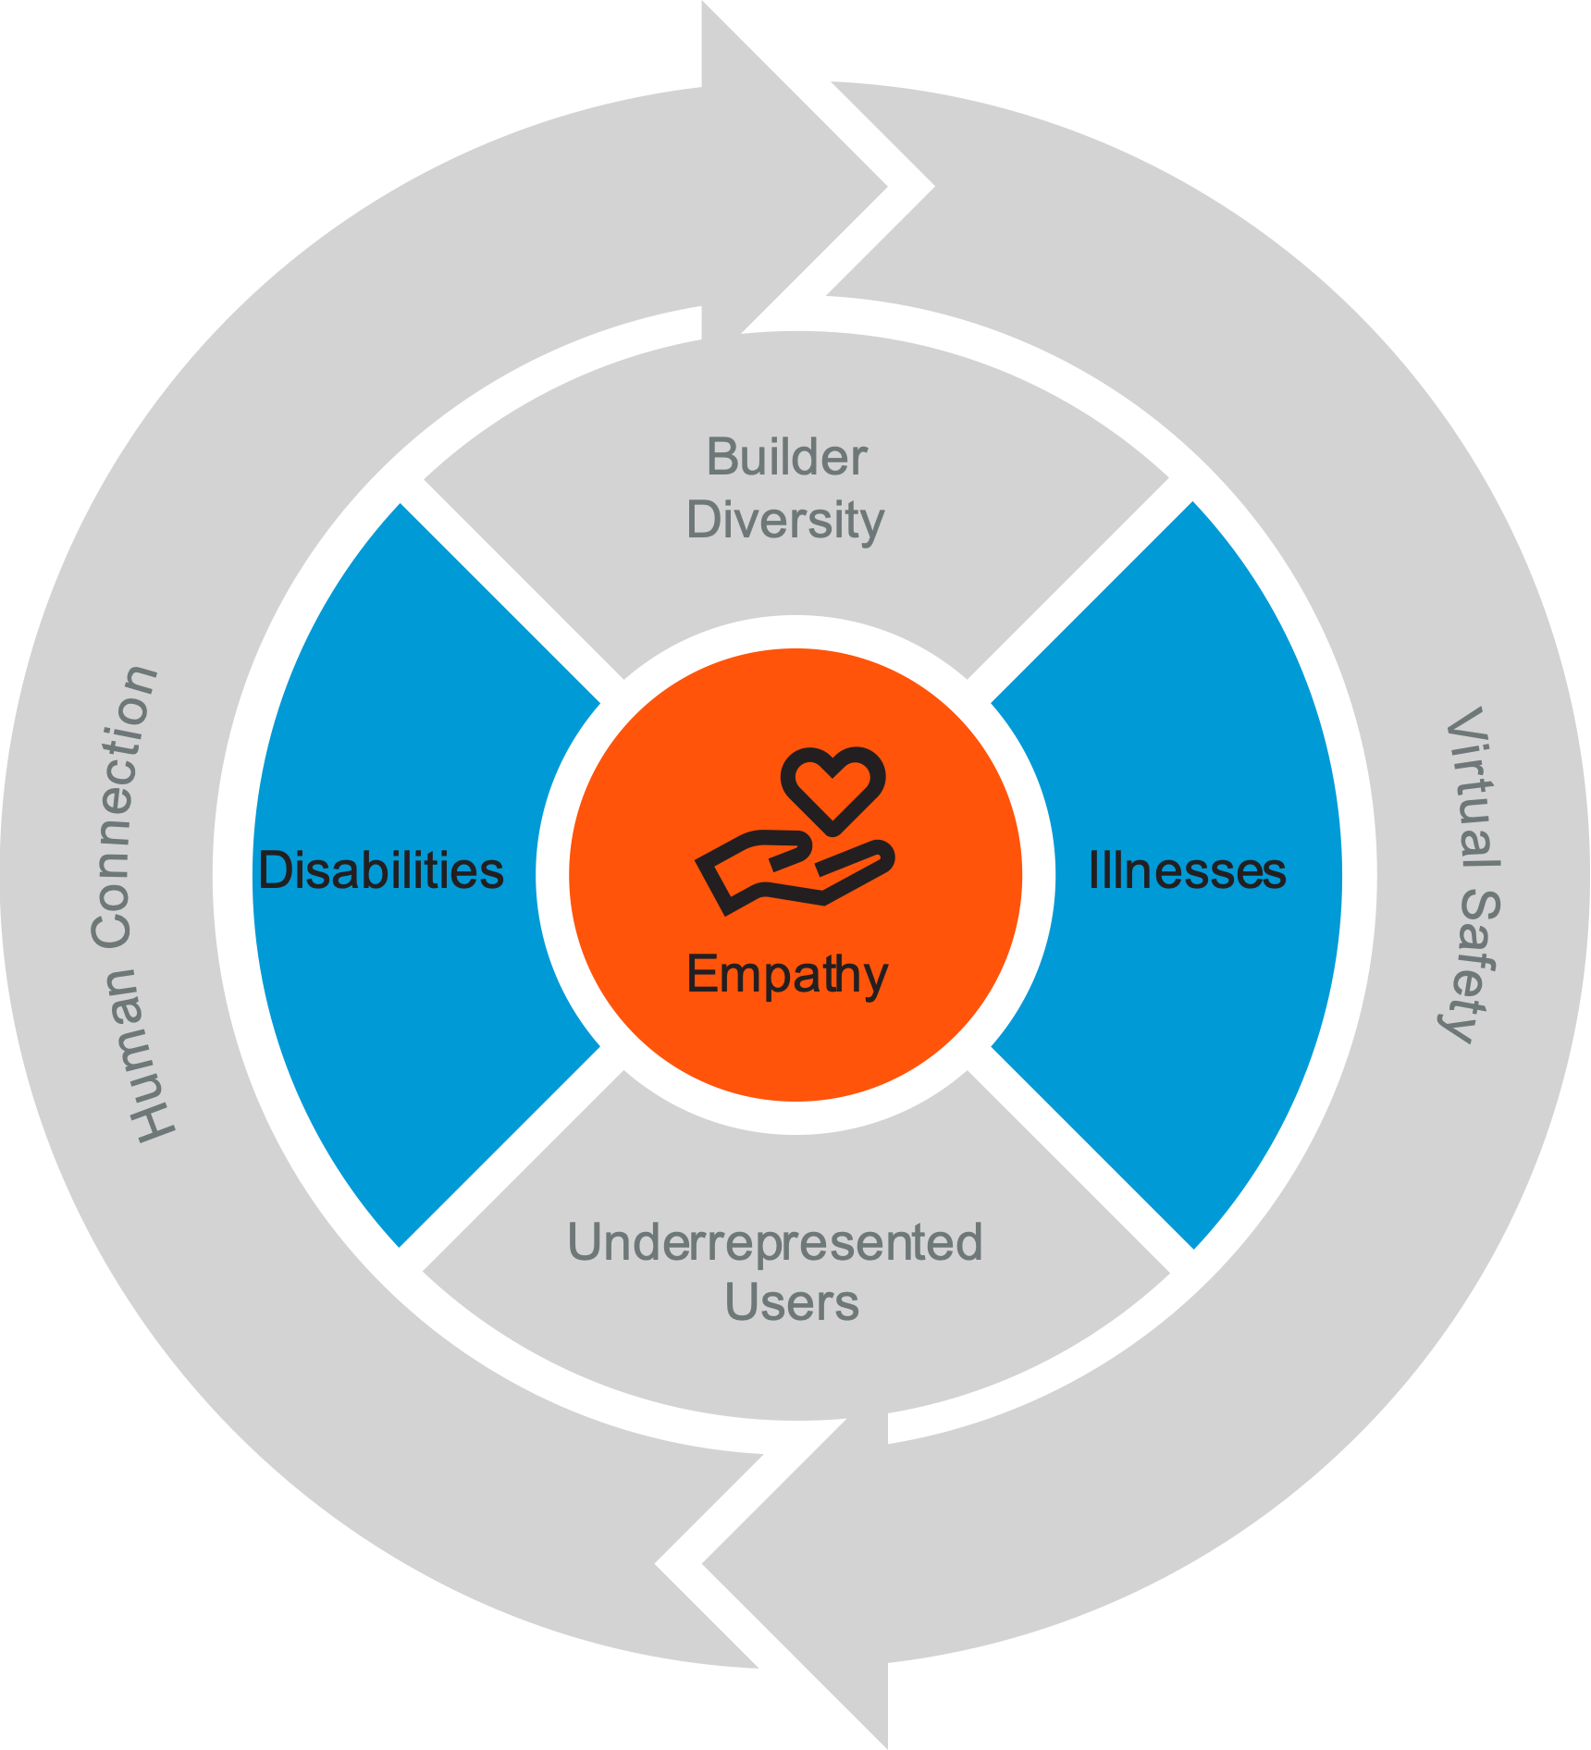
Empathy Should Be Expansive and Inclusive
Disabilities
AI-powered and eye-controlled avatar, closed captioning for the hearing-impaired and 3D echolocation and haptic feedback to make content accessible for the visually impaired
Illness
Immersive environments and digital twins
Source: Gartner
Notes:
In the metaverse, empathy should be expansive and inclusive, addressing real-world challenges that humans experience including, but not limited to:
The metaverse can be designed to consider conditions that limit a person’s movements, senses and activities in the real world and make it possible for those experiencing disability to participate fully. Some solutions like AI-powered and eye-controlled avatar, closed captioning for the hearing-impaired and 3D echolocation and haptic feedback to make content accessible for the visually impaired are all possible ways to enable those experiencing disability in the real world to interact in the metaverse without impairment.
The metaverse can be designed for people who are living with chronic and neurological conditions or life-threatening illness in the real world. The metaverse could bring in these segments of population by altering VR design aspects. Immersive environments where participants can gain access to care and digital twins in the metaverse are two areas of innovation in clinical areas being explored in the metaverse.
https://www.forbes.com/sites/nextavenue/2022/04/15/for-older-adults-a-hitchhikers-guide-to-the-metaverse/?sh=154a02d73477

Slide 9
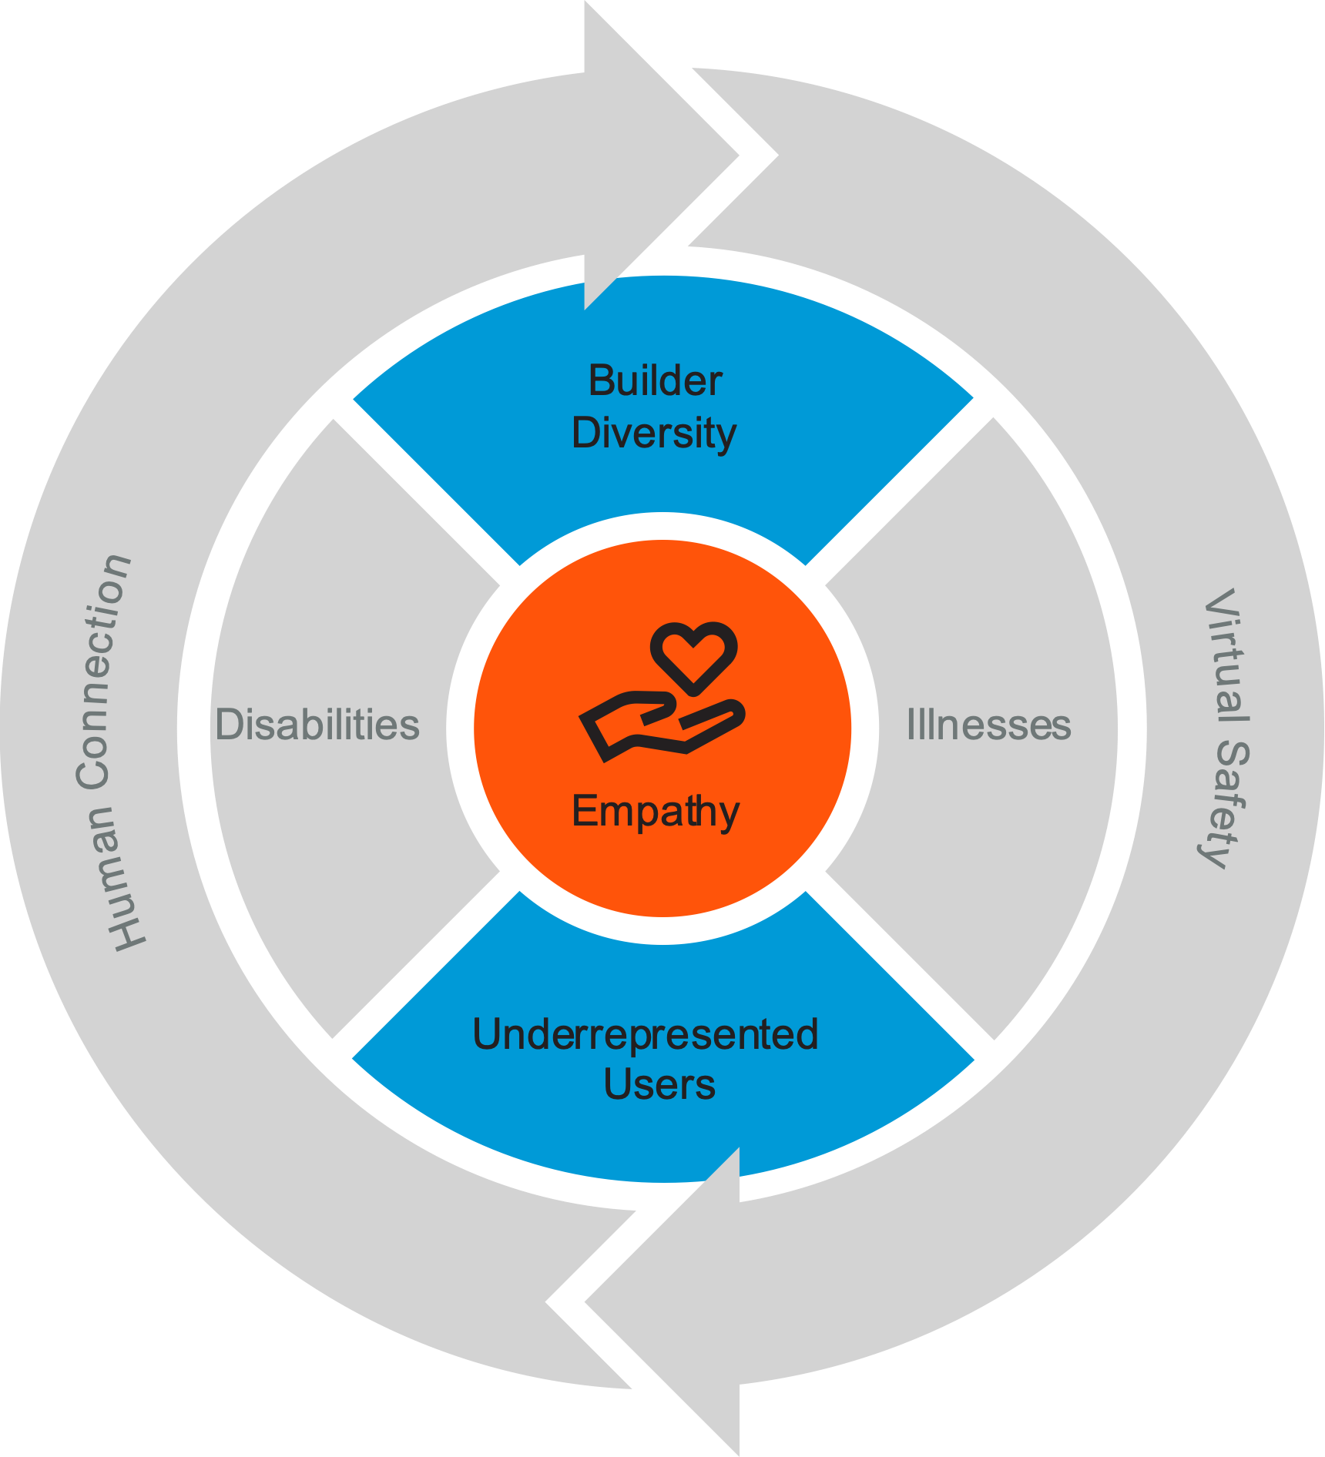
Empathy Includes Diversity and Representation
Builder Diversity
Currently, only 30% of game developers are women
Companies in the top quartile for gender diversity on executive teams are 25% more likely to have above-average profitability than their counterparts in the bottom quartile
Underrepresented Users
Opportunity to represent audiences who have historically been underrepresented from the creation stage
Implemented by Daz labs with their non-fungible people
Source: Gartner
Notes:
Diversity: To create an inclusive metaverse, diversity among those building it is paramount. Currently, only 30% of game developers are women. If specific groups of people are not represented in the metaverse, we will lose the diversity that can be so powerful in creating a product where everyone wants to participate fully. Companies in the top quartile for gender diversity on executive teams are 25% more likely to have above-average profitability than their counterparts in the bottom quartile, according to a 2019 McKinsey & Co. report.
Underrepresented: The metaverse presents an opportunity to represent audiences who have historically been underrepresented from the creation stage. This applies to, for instance, geographic differences, race, gender identities, sexual orientation, and religion. One example of how it can be done was implemented by Daz labs with their non-fungible people.
https://www.forbes.com/sites/nextavenue/2022/04/15/for-older-adults-a-hitchhikers-guide-to-the-metaverse/?sh=154a02d73477

Slide 10
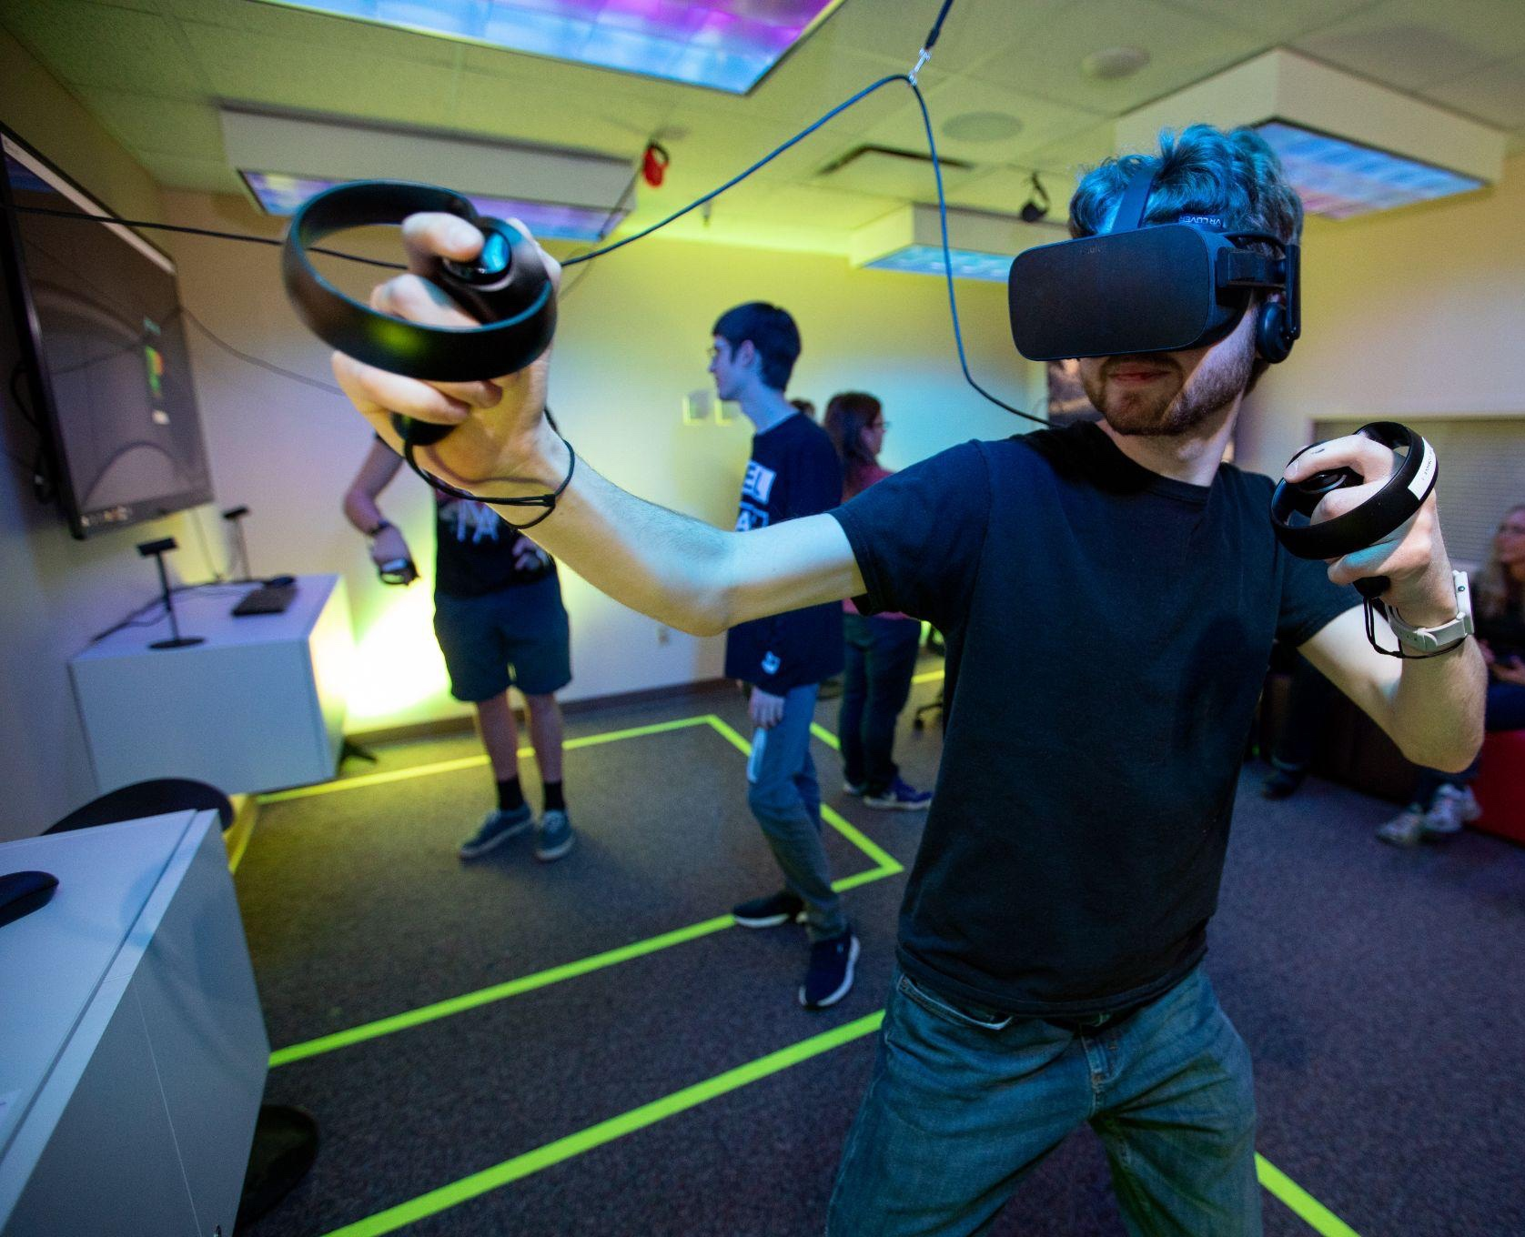
Phenomena for an Empathic Metaverse: Self-Other Merging Phenomenon
Self-other Merging Phenomenon – Defined as empathic concern, where you no longer see yourself and the person for whom you feel empathy as distinct, separate individuals.
Implication – Creating conditions in which avatars must adhere to empathic principles, can increase empathy in the behavior of individuals in the metaverse.
Source: By Geofflambeth - Own work, CC BY-SA 4.0, https://commons.wikimedia.org/w/index.php?curid=81083269
Notes:
Self-other phenomenon was defined by Decety, J., & Jackson, P. L. (2006) in Current Directions in Psychological Science.
Implication - When there are blurred boundaries between the self and others, it is easier to get immersed in the experience. In the real world, differences are emphasized, whereas in the metaverse, there is an opportunity to erase differences. One action that can be taken specifically in the metaverse, and not in the real world, is to design the virtual avatar to represent the person that one wants to be. Creating conditions in which avatars must adhere to empathic principles, can improve the potential of the self-other merging phenomena and increase empathy in the behavior of individuals in the metaverse.
https://en.wikipedia.org/wiki/Virtual_reality_game#/media/File:2487_cline_vr_studio_20190318.jpg

Slide 11

Phenomena for an Empathic Metaverse: The Proteus Effect
Proteus Effect – Defined as how people change their behavior in virtual worlds based on the characteristics of their avatar, such as visual features
Implication - if you are taking on a role of a panda in a virtual world, you will fully take on the perceived characteristics of a panda like being shy or gentle.
Bottom Line: Use, self-other merging and Proteus effect phenomenon to build in empathy as ground stakes
Source: Rob (Flickr profile), CC BY 2.0 <https://creativecommons.org/licenses/by/2.0>, via Wikimedia Commons
Notes:
Yee and Bailenson first coined the term the Proteus effect in the context of a virtual world.
People will behave according to what is expected or stereotypical behavior based on the appearance of their avatars.
Bottomline - Use, self other merging and proteus effect phenomenon to build in empathy as ground stakes. If you design the metaverse to be a place with positive characteristics – with mutual empathy and avatars representing openness and inclusivity -- there is a heightened chance of participants staying when they are looking for a place to escape.
https://commons.wikimedia.org/wiki/File:Atlanta_Zoo_Panda.jpg

Slide 12

Inflection Point
Treat the metaverse virtual world purely as a place that is different from the real world and strive to keep it that way.
Design the metaverse with considerations for all abilities using solutions like skeletal animation, rigging, eye controlled, 3-D echolocation and haptic feedback.
Start with including a diverse workforce into your design labs.
Use debiasing techniques for training data at the inception stage of a metaverse world.
Treat metaverse as a useful vehicle that can be used to build social connections and a sense of community.
Source: Gartner
Notes:
Many realized during the pandemic how much they valued human connection and being in the physical presence of one another. And yet, we continue to experience dwindling attention spans and a lack of community feeling.
In this current state, the metaverse that is being built with neither concern for empathy and human connection nor safety considerations can only mean that it will play out for the short-term. What started as a place for people to connect will result in just another place where people feel unsafe and vulnerable. The metaverse will eventually be considered a fad. It will run its course and die.
In this alternate scenario – a metaverse with built-in empathy -- metaverse could be treated as a place where everyone comes for positive thoughts and a happy place, where people consistently look for creative solutions to common problems that benefit all parties. We would build in empathy and security considerations to create a human connection, where people work, shop, bank, receive care and attend social events. In this scenario, the metaverse becomes a useful vehicle that can be used to build social connections and a sense of community.
https://brand.gartner.com/file/gallery/id/23893

